Slide 1

Radiography Radiographic
Workforce UK Census
2022
207 Providence Square,
Mill Street, London SE1 2EW
www.sor.org

Slide 2

 |  |  | Slide
1. | Executive Summary |  | 5
2. | Therapeutic Radiographer UK-wide staffing position on 1 June 2023 |  | 7
3. | Methodology |  | 11
4. | Profile of respondent workforce size |  | 12
5. | NHS establishment and vacancies |  | 13
 | 5.1 | NHS establishment and vacancies by UK country | 13
 | 5.2 | NHS England by Radiotherapy Network Partnerships | 14
 | 5.3 | NHS workforce size trend | 15
 | 5.4 | NHS vacancy rate trend | 16
 | 5.5 | NHS provider vacancy rate distribution | 18
 | 5.6 | NHS workforce by Agenda for Change (AfC) band | 19
6 | Radiotherapy radiographic workforce in non-NHS radiotherapy providers |  | 20
7. | Staff in post |  | 21
8. | Job titles |  | 22
 | 8.1 | Job title establishment and vacancy frequency | 22
 | 8.2 | Job title trends | 25
9. | Establishment by site/ speciality |  | 26
10. | Long-term absence rate |  | 29
Contents
2
Radiography Radiographic Workforce UK Census 2022
207 Providence Square, Mill Street, London SE1 2EW. www.sor.org

Slide 3
 |  |  | Slide
11. | Retirements |  | 30
12. | Leavers |  | 31
13. | Recruitment |  | 33
 | 13.1 | International recruitment | 33
 | 13.2 | Return to practice | 34
 | 13.3 | Apprenticeships | 34
 | 13.4 | Students | 34
14. | Use of agency therapeutic radiographers |  | 35
15. | Downloads |  | 37
16. | References |  | 38
3
Radiography Radiographic Workforce UK Census 2022
207 Providence Square, Mill Street, London SE1 2EW. www.sor.org

Slide 4
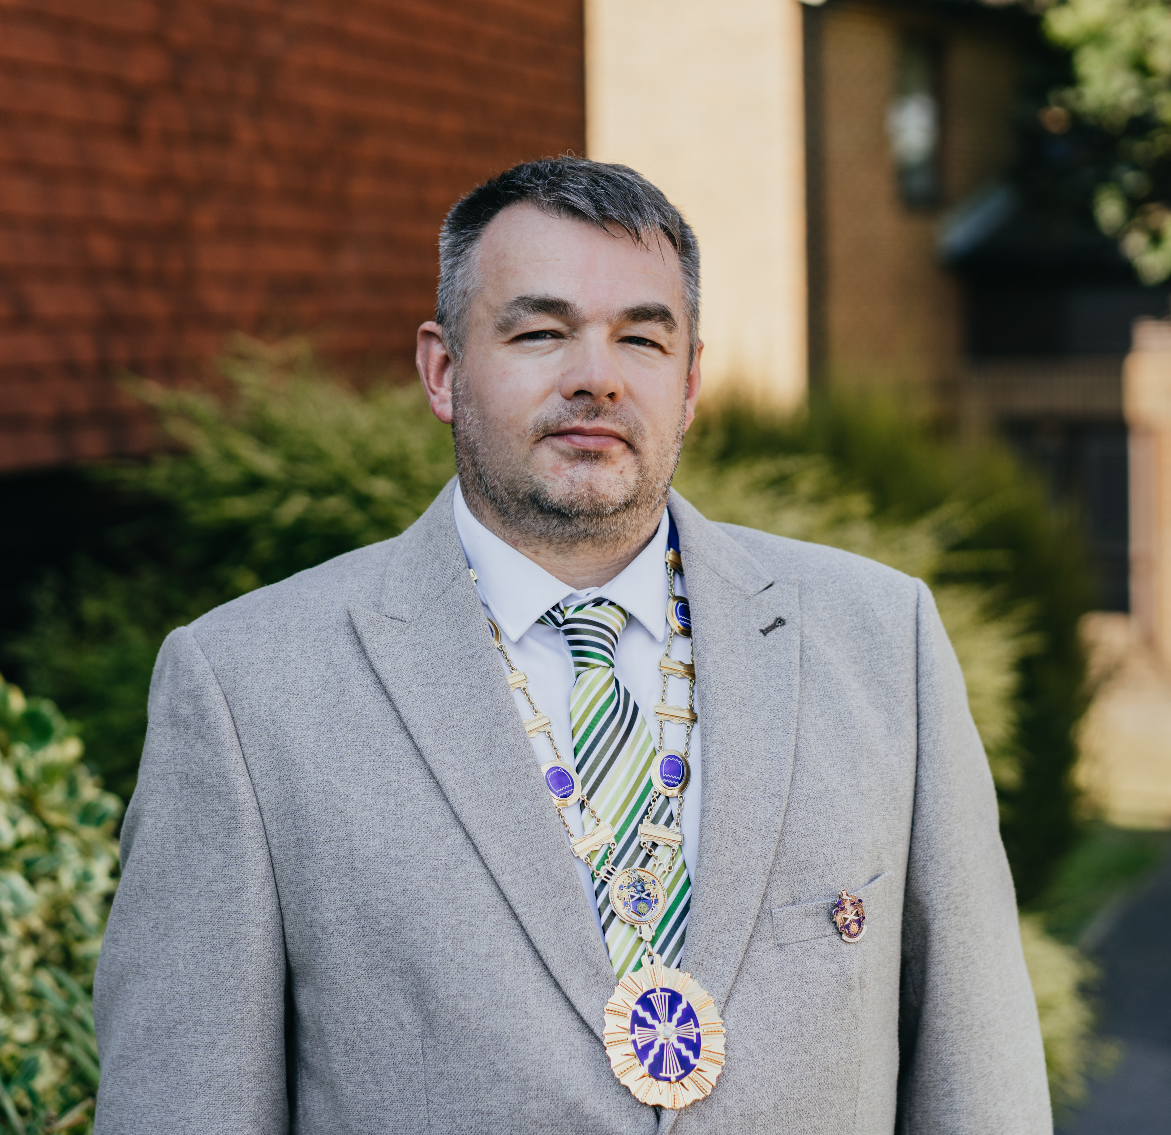

The Society of Radiographers (SoR) conducted a comprehensive census of the radiotherapy radiographic workforce in the UK on 1 November 2022. This census specifically targeted radiotherapy providers in the NHS and other healthcare sectors across England, Northern Ireland, Scotland and Wales.
The main objectives of the census were to determine the workforce's size, structure, nature and vacancy rate. This report presents a detailed analysis of the census results and offers a comparison with previous annual surveys conducted between 2012 and 2021 (see references).
We wish to thank the service leads at the 62 radiotherapy providers who responded to the online questionnaire. This is a response rate of 89%. The data they supplied can provide important evidence to workforce planners, clinical boards, government departments, educators, commissioners and radiotherapy providers.
This census report also includes a snapshot of the therapeutic radiographer UK-wide staffing position on 1 June 2023 based on a survey of radiotherapy managers and data on patient activity from NHS Digital.
Foreword
President, Society and College of Radiographers
Dave Pilborough
4
Radiography Radiographic Workforce UK Census 2022
207 Providence Square, Mill Street, London SE1 2EW. www.sor.org

Slide 5
These are the main findings:
The total NHS radiotherapy radiographic workforce is 3902.9 whole time equivalent (WTE) comprising 3746.1 WTE therapeutic radiographers and 156.89 WTE assistant practitioners, trainee assistant practitioners
(APs/TAPs) and clinical support workers.
The NHS radiotherapy radiographic workforce grew by 36.85% between 2012 and 2022.
The current vacancy rate for the NHS radiotherapy radiographic workforce is 10% with 395.27 WTE radiotherapy radiographic positions vacant. This is the highest recorded vacancy rate since we began collecting data in this format in 2012. The rate has grown from 6.1% in 2018 to 10% in 2022.
The current vacancy rate for NHS therapeutic radiographers is 9.7% and for associated Assistant Practitioners’ s/Trainee Assistant Practitioner’s and clinical support workers it is 15.1%.
The NHS current vacancy rate varies by UK country: England 10.23%, Northern Ireland 6.22%, Scotland 8.10% and Wales 12.29%.
The Thames Valley / Wessex network has the highest current vacancy rate of the English NHS radiotherapy network partnerships at 17.20%.
The three-month vacancy rate for the NHS radiotherapy radiographic workforce is 6.17%. This is an increase from the 2021 census three-month vacancy rate which was 5.5%.
84% of the NHS radiotherapy radiographic workforce is employed in Agenda for Change (AfC) bands 5 to 7.
1
Executive
Summary
The following bullet points highlight the main findings
for this census:
1.1
NHS findings
5
Radiography Radiographic Workforce UK Census 2022
207 Providence Square, Mill Street, London SE1 2EW. www.sor.org

Slide 6
The average ratio of the number of staff in post WTE to the number of staff headcount 0.91 in the NHS. This number gives an indication of the numbers of staff who don’t work full-time and can help in workforce planning.
There are 287 job titles in use in radiotherapy providers in the UK for the radiotherapy radiographic workforce.
The percentage of the radiotherapy radiographic workforce (headcount) on long-term leave is 3.7% comprising 0.2% on a career break, 1.9% on non-Covid-19-related long-term sickness absence, 0.2% on Covid-19-related long-term sickness absence and 1.4% on parental leave.
1.1% of the radiotherapy radiographic workforce is due to retire in the coming year, 0.9% in the subsequent year and 2.9% in the following three years.
The radiotherapy radiographic workforce annual turnover is 7.6% by headcount. The highest turnover rate of 20.18% is seen at AfC band 5. A high turnover puts indirect pressure on resources by increasing the need for recruitment activities and induction training.
Respondents have recruited 1.6% of their headcount internationally over the past year and intend to recruit a further 1.1% in the coming year.
Twelve (19%) of the 62 respondents to the return to practice question supported a return to practice radiographer in the year up to the census date.
Currently; 22 (35%) of the 62 respondents reported having staff in an apprenticeship opportunity in the year up to the census date. The data shows the AfC band with the highest percentage of apprenticeships roles are within Band 3 and Band 7 at 20%.
As of the census date, 40% of respondents are using agency therapeutic radiographers. This compares with 33% in the 2021 edition of the census and 36% in the 2020 edition.
There are 75.6 therapeutic radiographers (headcount) working in dosimetry in the 61 providers who responded to this question. These numbers represent those working within the budgetary control of the radiotherapy service manager. In addition, 93 therapeutic radiographers are reported to work in cancer services (such as research) outside the budgetary control of the radiotherapy service manager (and are therefore unlikely to be included in data elsewhere in this report).
1.2
Findings including both NHS and non-NHS radiotherapy providers
6
Radiography Radiographic Workforce UK Census 2022
207 Providence Square, Mill Street, London SE1 2EW. www.sor.org

Slide 7
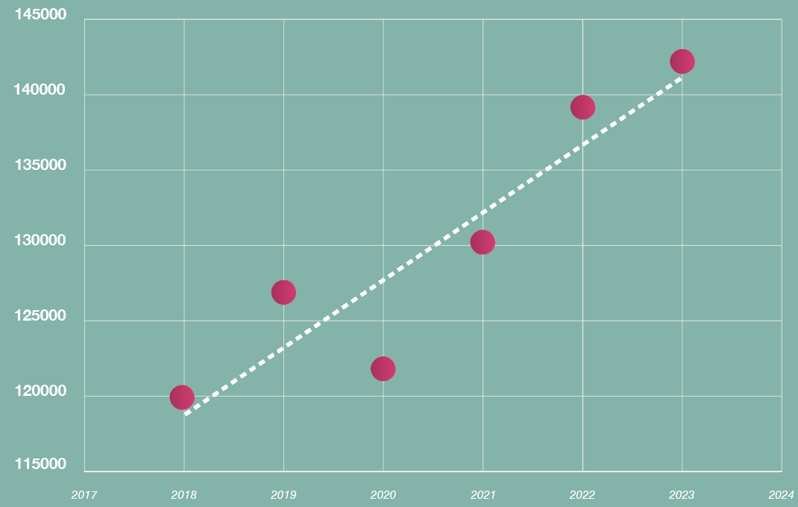
The data to produce the snapshot of therapeutic radiographer staffing covered in this section has been collated and analysed by Carol Scott, radiotherapy services manager at Oxford University Hospitals NHS Foundation Trust.
The Therapeutic Radiographer workforce, the only staff group legally registered to deliver radiotherapy in the UK, continues to be under considerable strain due to increasing workload, increasing complexity of treatments being planned and delivered and high staff vacancy rates.
Staff shortages are affecting the ability of departments to use all their available planning and treatment equipment capacity. This has an impact on the timeliness of delivering patient care, the patient experience and the morale of those staff currently in post.
The graph in Figure 1 shows the actual UK-wide numbers of new patient episodes of radiotherapy between January 2018 and May 2023, as reported on NHS Digital’s National Disease Registration Service (NDRS) CancerStats2 data tool, with an estimate for the full-year effect in 2023 based on activity from January to May 2023. There was a brief period of reduced referrals due to Covid-19 in the first financial quarter of 2020/21, but activity levels soon recovered and then increased in 2021 and 2022. In each of the years 2021 and 2022 activity increased by around 7.5% on the previous year. Between 2019 and the end of 2022 there has been a 9.6% overall increase in the numbers of new episodes of treatment. This increase puts increasing pressure on the planning elements of the radiotherapy pathway.
2
Therapeutic Radiographer UK-wide staffing position on 1 June 2023
Figure 1: New radiotherapy patient
episodes
*2023 annual figure based on estimates of activity delivered to May 2023
In 2020 research evidence showed that the UK could safely adopt hypofractionation for some breast cancer treatments, meaning a higher dose of radiation is delivered per treatment session, so patients can complete their course of radiotherapy much faster. Approximately 60% of all breast cancer radiotherapy is now safely delivered in five attendances for treatment compared with the previous standard practice of 15 attendances. The increasing introduction of hypofractionation regimes, as more research evidence is published, is often cited as having a significant benefit for managing demand for radiotherapy treatment.
As Figure 1 shows, the number of patients being referred for radiotherapy continues to increase, meaning that the benefits of hypofractionation schedules on demand are temporary and only available for a short period. In about the time it takes to train a therapeutic radiographer, the number of attendances for treatment are back to previous levels.
Moving staff resources from the treatment to the planning part of the pathway to cope with increasing numbers of referrals is therefore not possible if activity levels are to be maintained to meet demand.
This is demonstrated in the graph in Figure 2, which shows the actual numbers of treatment delivered, as reported to CancerStats2, between 2018 and 2022 and the estimated numbers for 2023.
2023 data is based on activity reported to CancerStats2 from January to March 2023 inclusive, before industrial action in the NHS began to impact on cancer treatment activity, both surgical and non-surgical. This overall slowdown in activity in 2023 is published in cancer waiting time data by NHS England (NHSE) and the three devolved nations.
7
Radiography Radiographic Workforce UK Census 2022
207 Providence Square, Mill Street, London SE1 2EW. www.sor.org

Slide 8
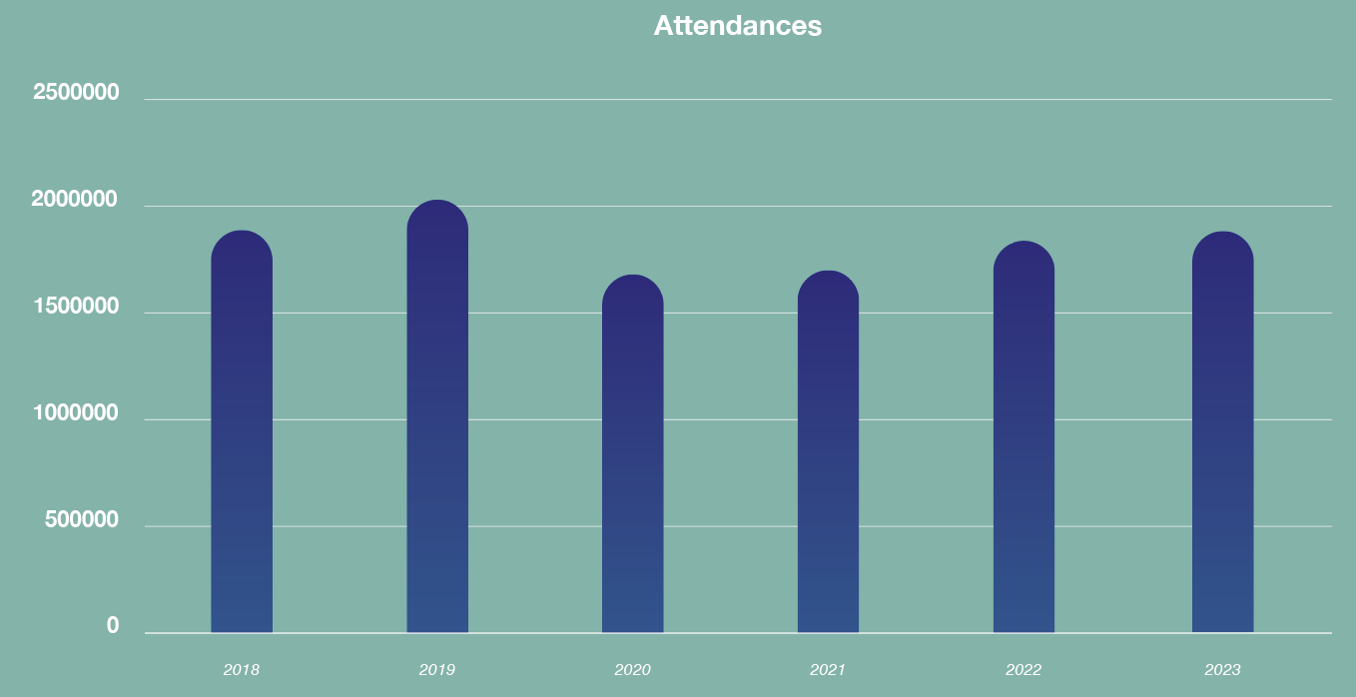
The College of Radiographers (CoR) conducts an annual workforce census in November each year. Most newly registered UK-trained staff qualify in July and enter the workforce in the three months following qualification. The November picture is anecdotally more positive than the situation later in the year, as there are newly qualified staff filling vacant posts, hence the reason for carrying out a snapshot survey in June 2022 and repeating it again in 2023. The CoR survey also reports on the numbers of posts that have been vacant for more than three months. As staff leave during the year, they either move to another department, which does not improve the UK-wide position overall, or they leave the therapeutic radiographer workforce for alternative roles in the NHS or the NHS for a different career. There is no indication that high numbers of staff are leaving to work in the private sector, which has contracted over the last year in the UK.
Multiple factors are affecting staff retention and recruitment; this report does not seek to address these, only to highlight the current situation. The survey asked radiotherapy managers to provide snapshot data giving the position in each department UK-wide on 1 June 2023. The UK current funded WTE is not set or benchmarked against a nationally standardised safe staffing model. Increases in budget to increase workforce depends on individual managers making a successful bid for additional workforce when, in their professional opinion, the numbers are unsafe. As a small profession in a specialty that is not widely well understood, it is often extremely difficult to make this case and achieve additional funding. Even when funding is secured, there are not enough therapeutic radiographers available to recruit in the UK to fully staff all departments, so there will always be vacancies across the four UK nations.
In the 2023 snapshot survey, 100% of departments responded to the questions shown in Figure 3, with their responses compared with the 2022 responses.
WTE vacancies
(in funded establishment)
The data shows there were 360.63 therapeutic radiographer posts vacant in the UK on 1 June 2023. When compared with the SCoR 2022 census data of a 3795.4 WTE UK-wide funded establishment this equates to 9.5% of all posts vacant.
Only four departments were fully staffed against the funded establishment on this date. These staffing shortages are being experienced across the UK, not just focused in specific regions. The number of vacancies ranges between 0.7 WTE and 31.3 WTE, with the mean being 5.9 WTE. The SCoR 2022 census data shows the NHS UK-wide average WTE funded establishment per department as 61.2 WTE.
WTE working out notice period
A further 63 WTE staff were working out their notice period, which equates to a further 1.65% of the 2022 UK-wide WTE funded establishment.
Those already working out their notice on 1 June 2023 and moving to another UK radiotherapy department would be in post by 31 August 2023 and therefore are included in the new starter figure.
Departments reported that staff are either leaving the profession for different roles in the NHS or healthcare or leaving the NHS completely for other careers, and some also reported an increase in those taking early retirement.
WTE on parental leave
128.55 WTE were on parental leave, which equates to 3.4% of the WTE UK-wide establishment. Not every department had been able to backfill those posts to cover the leave period and all but one department with staff on parental leave reported vacancies.
WTE on long-term sickness
73.46 WTE staff were absent due to long term sickness, a further 1.94% of the total funded establishment.
Figure 2: Number of patient attendances for treatment
*2023 full-year figure estimated attendances for treatment
8
Radiography Radiographic Workforce UK Census 2022
207 Providence Square, Mill Street, London SE1 2EW. www.sor.org

Slide 9
Machines closed due to staff shortages with brief description
31% of departments reported that they were having to reduce capacity due to staff shortages and employing measures including:
closing a linear accelerator (linac) or computed tomography (CT) machine completely for weeks or months
operating linacs and CT machines for reduced hours of the day
completely closing radiotherapy planning CT services on certain days because there were insufficient staff to open them for longer
reducing linac hours to accommodate essential staff breaks
reducing CT planning capacity to release staff to cover treatment machines
Position following recruitment of 2023 graduates
Confirmed new starters in post by 31 August 2023 were reported to be 137.54 WTE, so only 38% of vacancies reported on 1 June 2023 would be filled by this date and reduced capacity would continue. A further 86.94 WTE were expected to be in post by 30 September 2023, meaning 38% of the vacancies reported on 1 June 2023 would still remain unfilled.
After the recruitment of new graduates, for the remainder of the year any additional increase in numbers recruited to the overall UK workforce comes only from overseas recruitment or individuals who want to return to practice.
To date there has been no financial support from NHSE or the three devolved nation NHS authorities for those Trusts employing Therapeutic Radiographers from overseas, unlike Diagnostic Radiography where funding has been made available.
Local arrangements for providing financial support for Therapeutic Radiography recruits’ travel costs, visas and accommodation on arrival are very variable and rarely cover all these expenses, leaving the individual overseas employee to meet all or some of the costs. The process is lengthy and can take up to six months from offering a position to the individual starting work.
Those returning to practice after a break of two or more years have very limited funding support, do not receive a salary during the retraining period and must cover all living expenses themselves. The figures show this is not a popular option and there is very little uptake.
While new graduates are always a welcome addition to the workforce, they do not replace the experience and skills of those who have left the profession or those who have moved into dosimetry, research, advanced practitioner, consultant practitioner and education roles.
Having staff in posts such as those listed above is vital to maintain overall radiotherapy service delivery and high-quality patient care.
It provides a career path for individuals interested in such roles and aids retention in the overall radiotherapy service.
The 2022 CoR census has found that over 21% of the total UK Therapeutic Radiographer workforce were employed in these roles.
Whether new starters are recent graduates or overseas recruits, they need a period of induction and mentorship to settle into the NHS workplace. All new staff require induction and training to achieve the necessary competencies to work at the level required by their job role and banding at their employing organisation. All of this takes input from existing staff in a department to deliver the training and support.
In conclusion, the workforce figures indicate a slight improvement for Therapeutic Radiographers on the June 2022 position. This is positive but, against a background of increasing complexity and volume of work, current financial pressures and an uncertain climate in the NHS, without sustained investment to increase staffing numbers the existing workforce is not sufficient to meet demand. The future workforce will not support the continuing increase in demand unless there are initiatives to address the shortfall.
Simply translated, patients will be waiting longer to receive their cancer treatment.
9
Radiography Radiographic Workforce UK Census 2022
207 Providence Square, Mill Street, London SE1 2EW. www.sor.org

Slide 10
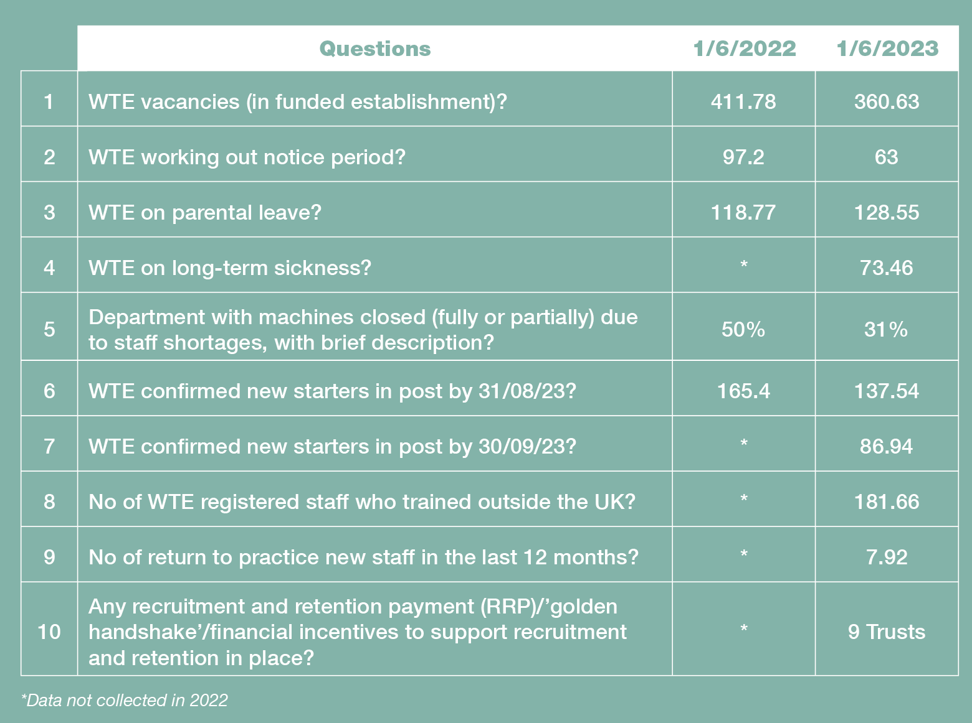
Note: The self-reported survey data is collected in the same way as the CoR survey data. This has not been independently verified against NHS national workforce data.
Figure 3: Responses
to survey questions
10
Radiography Radiographic Workforce UK Census 2022
207 Providence Square, Mill Street, London SE1 2EW. www.sor.org

Slide 11
The SoR 2022 workforce census captures data about the UK radiotherapy radiographic workforce at the census date of 1 November 2022. Data collection was performed between November 2022 and March 2023 by means of an Alchemer® online questionnaire distributed to radiotherapy service managers. The census asked for the total numbers of therapeutic radiographers, assistant practitioners (APs), trainee assistant practitioners (TAPs) and clinical support workers delivering radiotherapy (together referred to as the ‘radiotherapy radiographic workforce’ in this report) within the budgetary control of the radiotherapy service manager. Radiotherapy helpers and administration staff are not included in the numbers. Notably, starting from 2021, the census has been expanded to include clinical support workers in its data collection.
Respondents were asked:
Their contact details and job title
The name of the radiotherapy provider on whose behalf they were responding
Number of treatment machines and total daily number of clinical hours
Establishment numbers by AfC band – WTE
Numbers of staff in post by AfC band – WTE
Number of staff in post by AfC band – headcount
Number of staff in an apprenticeship role by AfC band
Vacancy WTE numbers by AfC band – current and three-month and job titles
WTE establishment by site and career progression level
Long-term absence headcount numbers by AfC band – career break, long-term sickness absence and parental leave
Headcount predicted to retire in the coming year, subsequent year and further 3 years by AfC band
Headcount of leavers in the previous year by AfC band and reasons for leaving
Job titles in use
Recent and planned international recruitment by AfC band
Support of return to practice radiographers and students
Use of agency therapeutic radiographers
Therapeutic radiographers employed in dosimetry and other cancer services not within the budgetary control of the radiotherapy service manager
The previous census in 2021 introduced questions relating to the number of commissioned radiotherapy treatment machines and daily hours of external beam radiotherapy. These queries have now been extended to encompass data collection on linear accelerators (linacs), planning magnetic resonance imaging (MRI) and planning CT machines. This report assumes that numbers reported in AfC band 3 refer to clinical support workers delivering radiotherapy or TAPs, numbers reported in AfC band 4 refer to APs and numbers reported in AfC band 5 and above refer to therapeutic radiographers. The report excludes the physics and engineering radiotherapy workforce and clinical oncologists. Enquiries about the physics and engineering workforce in radiotherapy should be directed to the Institute of Physics and Engineering in Medicine. Enquiries about the clinical oncology workforce should be directed to the Royal College of Radiologists. Links to the full set of questions for the 2022 census and a spreadsheet with a breakdown of the principal data by radiotherapy provider can be found in the Downloads section of this report.
60 out of 61 NHS providers of radiotherapy services in the UK submitted data to the current 2022 census. In addition, two independent (non-NHS) providers of radiotherapy services responded (out of a maximum of ten), giving a 87% response rate overall. HCA Healthcare UK provided five responses from the five branches of their radiotherapy provisions. The number of respondents whose data is being used in each question is shown by the ‘n’ value below tables and figures. This ‘n’ value is the number of respondents to the question in the 2022 census.
3
Methodology
11
Radiography Radiographic Workforce UK Census 2022
207 Providence Square, Mill Street, London SE1 2EW. www.sor.org

Slide 12

4
Profile of respondent workforce size
Size distribution of 2022 census respondents
Figure 4 shows the distribution of the 62 respondents to the 2022 census in terms of the size of their radiotherapy radiographic workforce WTE. 69% of the NHS respondents to the census have fewer than 80 radiotherapy radiographic workers WTE. Both of the non-NHS respondents have fewer than 40 radiotherapy radiographic workers WTE.
Figure 4: Radiotherapy radiographic workforce WTE size distribution of
2022 census respondents (n=62)
Number of respondents
Radiotherapy radiographic workforce WTE
Figure 4
Radiography Radiographic Workforce UK Census 2022
207 Providence Square, Mill Street, London SE1 2EW. www.sor.org

Slide 13
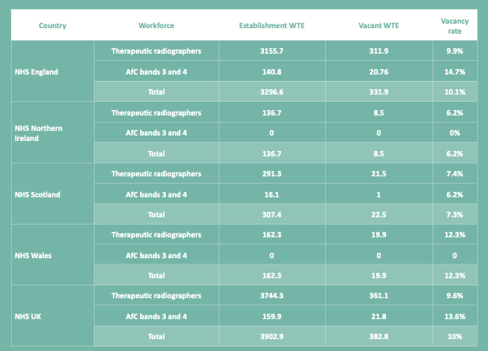
5
NHS establishment and vacancies
5.1
NHS establishment and vacancies by UK country
Table 1 shows the total NHS WTE of 3902.95 broken down by country. The vacancies and vacancy rates are also displayed.
Table 1: NHS radiotherapy radiographic workforce establishment WTE, vacant WTE and vacancy rate by UK country (n=60)
Caution requires: Vacancy numbers were not received from one of the three Welsh radiotherapy providers.
Table 1
Radiography Radiographic Workforce UK Census 2022
207 Providence Square, Mill Street, London SE1 2EW. www.sor.org

Slide 14
5.2
NHS England by Radiotherapy
Network
Partnerships
There are eleven operational delivery networks set up by NHS England to provide specialised radiotherapy services across a region. Each network partnership includes at least two NHS radiotherapy providers and is aligned to at least one cancer alliance. Table 2 shows the workforce situation in England by radiotherapy network partnership region. The Thames Valley and Wessex Radiotherapy Operational Delivery Network has the highest current vacancy rate at 17.20%.
Table 2: NHS radiotherapy radiographic workforce establishment WTE, vacant WTE and vacancy rate by English radiotherapy network partnership region (n=60)
Table 2
Radiography Radiographic Workforce UK Census 2022
207 Providence Square, Mill Street, London SE1 2EW. www.sor.org

Slide 15
Size of NHS radiotherapy radiographic workforce 2012 to 2022
5.3
NHS
workforce
size trend
The 2022 CoR census found the NHS radiotherapy radiographic workforce grew by 1051 WTE (36.8%) between 2012 and 2022, as shown in Figure 5.
Figure 5: Size of the UK radiotherapy radiographic workforce WTE, 2012 to 2022 (n=60)
Whole time equivalent (WTE)
Census year
Figure 5
Radiography Radiographic Workforce UK Census 2022
207 Providence Square, Mill Street, London SE1 2EW. www.sor.org

Slide 16

Current vacancy rate of NHS radiotherapy rediographic workforce
2012 - 2022
5.4
NHS
vacancy rate trend
The current vacancy rate for the NHS radiotherapy radiographic workforce as a whole is 10%, as shown in Figure 6. This is the highest recorded vacancy rate since we began collecting data in this format in 2012. The rate has grown from 6.1% in 2018 to 10% in 2022. Figure 6 also shows the specific vacancy rate among NHS therapeutic radiographers only.
Figure 6: Current vacancy rate of NHS radiotherapy radiographic workforce, 2012 to 2022 (n=60)
Vacancy WTE as a percentage
of establishment WTE
Census year
Figure 6
Radiography Radiographic Workforce UK Census 2022
207 Providence Square, Mill Street, London SE1 2EW. www.sor.org

Slide 17
Three-month vacancy rate of NHS radiotherapy
radiographic workforce 2012 to 2022
Respondents to the census also reported the number of posts that had been vacant for three months. The results illustrated in Figure 7 show a three-month average vacancy rate of 7.1% for the NHS radiotherapy radiographic workforce. This is an increase on the 2021 census three-month vacancy rate of 5.5%.
Figure 7: Three-month vacancy rate of NHS radiotherapy radiographic workforce, 2012 to 2022 (n=60)
Vacancy WTE as a percentage
of establishment WTE
UK country or NHS region
Figure 6
Radiography Radiographic Workforce UK Census 2022
207 Providence Square, Mill Street, London SE1 2EW. www.sor.org

Slide 18
NHS provider vacancy rate distribution
5.5
NHS
provider
vacancy rate
distribution
Figure 8 shows the distribution of NHS provider current vacancy rates. Seven NHS providers have current vacancy rates above 20%.
Figure 8: Distribution of NHS provider current vacancy rates (n=60)
Number of NHS providers
Vacancy WTE as a percentage of establishment WTE
Figure 8
Radiography Radiographic Workforce UK Census 2022
207 Providence Square, Mill Street, London SE1 2EW. www.sor.org

Slide 19
5.6
NHS
workforce by Agenda for Change (AfC) band
Table 3
Average radiotherapy radiographic workforce
WTE per provider by Agenda for Change band (NHS)
According to the 2022 census, 84% of the NHS radiotherapy radiographic workforce are in AfC bands 5 to 7, as shown in Table 3 and Figure 9.
Table 3: NHS radiotherapy radiographic workforce WTE by AfC band (n=60)
Figure 9: Average radiotherapy radiographic workforce establishment WTE per NHS provider by AfC band (n=60)
Figure 9
Radiography Radiographic Workforce UK Census 2022
207 Providence Square, Mill Street, London SE1 2EW. www.sor.org

Slide 20
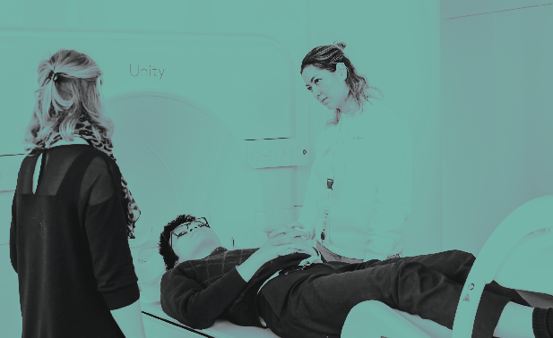
6
Radiotherapy
radiographic workforce in non-NHS radiotherapy providers
Two of the ten non-NHS radiotherapy providers in the UK submitted data to the 2022 CoR census. Combined responses were received from the five branches of HCA Healthcare UK and these have been counted as a single response for the purposes of this census.
This means a total of two out of a possible ten responses were received, and due to the missing eight responses we have made no attempt to provide an overall picture of the radiotherapy radiographic workforce in the non-NHS sector in 2022. The establishment (WTE and headcount) and vacancy (WTE) data provided by the two non-NHS respondents is given in the data spreadsheet that accompanies this report.
From this point onwards, the analysis in our report incorporates the data from both NHS and non-NHS respondents.
Radiography Radiographic Workforce UK Census 2022
207 Providence Square, Mill Street, London SE1 2EW. www.sor.org

Slide 21
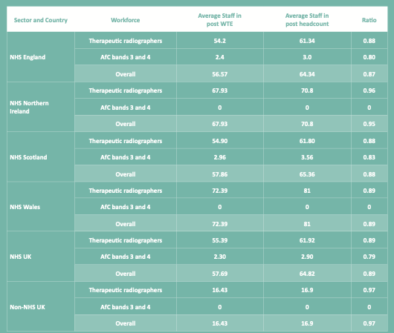
7
Staff in post
The average ratio of the number of staff in post WTE to the number of staff headcount is 0.88 in the NHS, based on results illustrated in Table 4. This ratio gives an indication of the number of staff in the radiotherapy radiographic workforce as a whole who do not work full-time, which can help in workforce planning.
Table 4: Radiotherapy radiographic workforce average staff in post by provider – WTE and headcount (n=62)
Table 4
Radiography Radiographic Workforce UK Census 2022
207 Providence Square, Mill Street, London SE1 2EW. www.sor.org

Slide 22
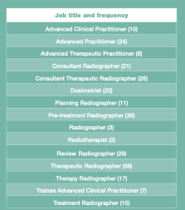
Additional job titles
The following additional job titles have been captured from the free text field section of the census so appear only once, for data collection purposes:
Advanced practice radiographer; radiotherapy review; imaging; R&D; advanced practitioner therapeutic; radiographer; apprentice therapeutic radiographer; cancer informatics lead radiographer; clinical specialist; clinical specialist radiographer; enhanced therapeutic radiographer; enhanced practitioner; Macmillan radiotherapy; specialist radiographer; operational manager; practice development radiographer; pre-treatment team leader; specialist practitioners; specialist radiographer; team lead; team lead radiographer; pre-treatment/treatment; trainee consultant; trainee consultant radiographer; treatment expert practitioner; treatment specialist; treatment team leader.
8
Job titles
8.1
Job title establishment and vacancy frequency
Our 2022 census found there are 287 job titles in use by radiotherapy providers in the UK for members of the radiotherapy radiographic workforce. Respondents were asked to confirm, from a given list, what title(s) are used in their centre. Table 5 shows the job titles used by two or more providers. Additional job titles collected in free text space on the census questionnaire are provided separately.
Table 5: Job titles used by two or more providers
Table 5
Radiography Radiographic Workforce UK Census 2022
207 Providence Square, Mill Street, London SE1 2EW. www.sor.org

Slide 23
Tables 6 and 7 show the job titles captured by the census by AfC band and how many providers had current vacancies and three-month vacancies in these posts.
Table 6: Job titles (number of providers reporting current vacancies in brackets by AfC band) (n=62)
Table 6
Radiography Radiographic Workforce UK Census 2022
207 Providence Square, Mill Street, London SE1 2EW. www.sor.org

Slide 24
Table 7: Job titles (number of providers reporting three-month vacancies in brackets) (n=62)
Table 7
Radiography Radiographic Workforce UK Census 2022
207 Providence Square, Mill Street, London SE1 2EW. www.sor.org

Slide 25

Frequency of selected job titles
8.2
Job title trends
Census respondents were also asked whether they used specific job titles. These selected job titles have been tracked across the 2020, 2021 and 2022 SoR census editions for trends in how frequently they are used by providers, as illustrated in Figure 10. They include the two protected titles within the radiotherapy radiographic workforce, which are ‘therapeutic radiographer’ and ‘radiographer’. (See the Health and Care Professions Council website for more information about protected titles.)
Figure 10: Frequency of use of selected job titles in the UK radiotherapy radiographic workforce (n=62)
Percentage of respondents using job title
Figure 10
Radiography Radiographic Workforce UK Census 2022
207 Providence Square, Mill Street, London SE1 2EW. www.sor.org

Slide 26
Enhanced, advanced and consultant practitioner establishment
WTE by site/speciality - total of all respondents
9
Establishment by site/ speciality
Respondents were asked to specify the number of radiotherapy radiographic practitioners by clinical site at different career progression/qualification levels. This allows the amount of practitioners for each site/speciality to be calculated and compared, as shown in Figure 11. The five sites/specialities with the largest number of enhanced, advanced or consultant practitioners are, in descending order: breast; technical development; prostate; research/clinical trials; and head and neck.
Figure 11: Total enhanced, advanced and consultant practitioner establishment WTE by site (n=62)
Total establishment WTE
Figure 11
Radiography Radiographic Workforce UK Census 2022
207 Providence Square, Mill Street, London SE1 2EW. www.sor.org

Slide 27
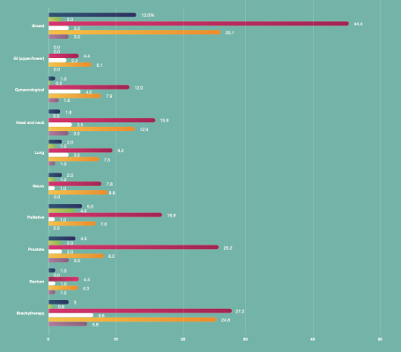
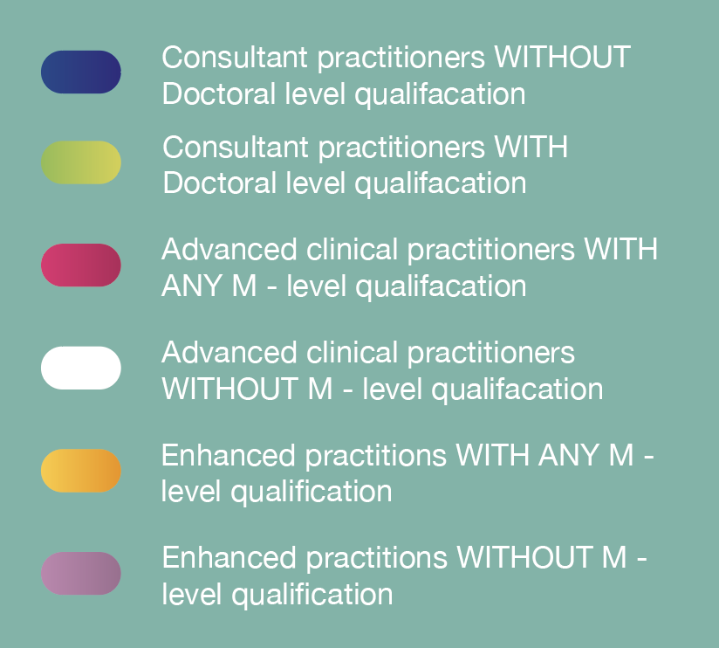
Enhanced, advanced and consultant practitioner establishment
WTE by site and career progression / qualification level
Figures 12 and 13 show the data from Figure 11 broken down by career progression/qualification level. The sites/specialities with the most consultant practitioners are, in descending order: breast; palliative; and prostate. For advanced practitioners, the most prevalent sites/specialities are: technical development; head and neck; breast; and prostate. The sites with the largest contingent of enhanced practitioners are breast and brachytherapy.
The data shows 82% of enhanced practitioners and 83% of advanced practitioners have a master’s level (M-level) qualification.
Figure 12: Enhanced, advanced and consultant practitioner establishment WTE by site and career progression/qualification level (n=62)
Establishment WTE
Figure 12
Radiography Radiographic Workforce UK Census 2022
207 Providence Square, Mill Street, London SE1 2EW. www.sor.org

Slide 28
Enhanced, advanced and consultant practitioner establishment
WTE by speciality and career progression / qualification level
Figure 13: Enhanced, advanced and consultant practitioner establishment WTE by speciality and career progression/qualification level (n=62)
Establishment WTE
Figure 13
Radiography Radiographic Workforce UK Census 2022
207 Providence Square, Mill Street, London SE1 2EW. www.sor.org

Slide 29
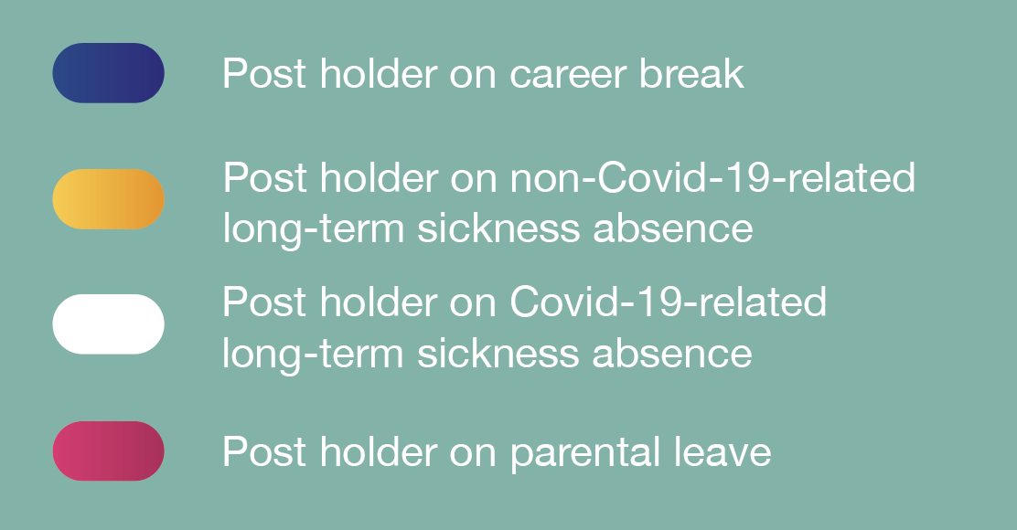
Long-term absence by Agenda for Change band
10
Long-term
absence rate
The census asked about reasons for long-term absence. It found 20.6 postholders, by headcount, are on a career break (0.2%), 74.4 are on long-term sickness absence not related to Covid-19 (1.9%), 12 are on Covid-19-related long-term sickness absence (0.2%) and 137.8 are on parental leave (1.4%). In total, an average of 3.7% of postholders, by headcount, are absent long-term due to career break, sickness absence or parental leave. Reasons for absence are illustrated in Figure 14, broken down by AfC job band.
Figure 14: Long-term absence rate by AfC band (n=62)
Agenda for Change band
Figure 14
Long-term absence as a percentage of headcount in post
Radiography Radiographic Workforce UK Census 2022
207 Providence Square, Mill Street, London SE1 2EW. www.sor.org

Slide 30
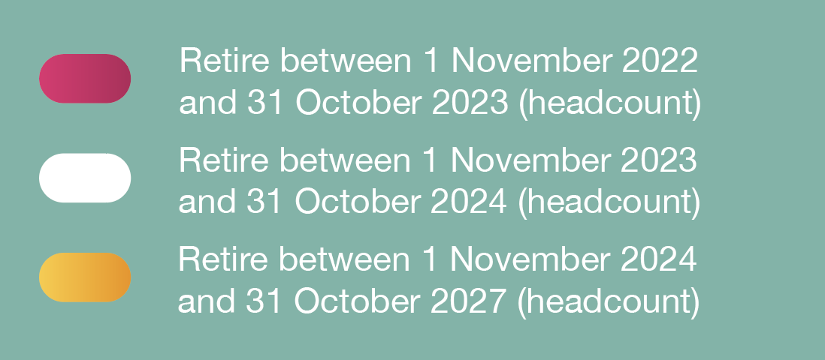
Retirements due by Agenda for Change band
11
Retirements
Respondents were asked about the number of radiotherapy radiographic workforce posts in their organisation where the postholder was due to retire in the coming year (November 2022 to October 2023), subsequent year and the following three years. Figure 15 presents the results stratified by AfC band. The 63 respondents to this question reported that 1.1% of their radiotherapy radiographic workforce by headcount were due to retire in the coming year, 0.9% in the subsequent year and 2.9% in the following three years. This gives an average retirement due rate in the next five years of 4.9%.
Figure 15: Retirements due by AfC band (n=62)
Retirements due (headcount) as a percentage of headcount in post
Figure 15
Radiography Radiographic Workforce UK Census 2022
207 Providence Square, Mill Street, London SE1 2EW. www.sor.org

Slide 31
Radiotherapy radiographic workforce turnover by Agenda for Change band
12
Leavers
Respondents were asked for the number of radiotherapy radiographic workforce posts where the postholder had left since the last census date (1 November 2021).
These responses have been used to calculate percentage turnover, defined as:
Turnover = 100 x Number of leavers in previouse 12 month period (headcount) Headcount in post
Workforce turnover puts indirect pressure on resources by increasing the need for recruitment activities and induction training. The average turnover for the 62 respondents to this question is 7.6%. Figure 16 breaks this down by AfC band; the highest turnover rate of 20.2% is seen at AfC band 5.
AfC band
Number of leavers in 12-month period as a percentage of headcount in post
Figure 16
Radiography Radiographic Workforce UK Census 2022
207 Providence Square, Mill Street, London SE1 2EW. www.sor.org

Slide 32

Reasons for therapeutic radiographers leaving their posts
The most common reasons radiotherapy providers gave on the census questionnaire for therapeutic radiographers leaving their post are still personal circumstances and promotion opportunities in another radiotherapy centre, as they were in the 2021 and 2020 censuses. This is illustrated in Figure 17.
Figure 17: Reasons for therapeutic radiographers leaving their post (n=62)
Percentage of respondents selecting reason
Figure 17
Radiography Radiographic Workforce UK Census 2022
207 Providence Square, Mill Street, London SE1 2EW. www.sor.org

Slide 33
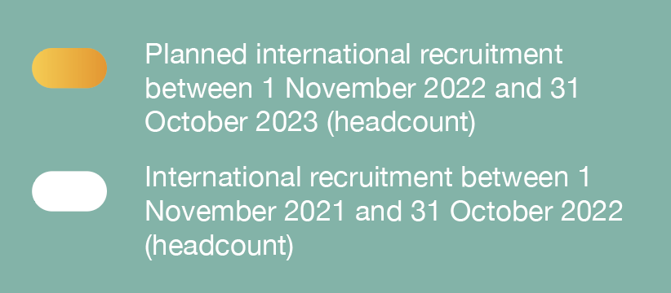
International recruitment during previous year and planned for coming year
13
Recruitment
13.1
International recruitment
Respondents were asked the number of radiotherapy radiographic workforce posts that have been, or are planned to be, recruited internationally. Overall, respondents had recruited 1.6% of their headcount internationally over the past year (to 1 November 2022) and intended to recruit a further 1.1% in the coming year. As shown in Figure 18, the international recruitment drive is largely centred on AfC band 5. By headcount, 4.9% of band 5 staff were recruited internationally over the past year.
Figure 18: International recruitment during previous year and planned for coming year by AfC band (n=62)
Agenda for Change band
Posts as a percentage of total headcount in post
Figure 18
Radiography Radiographic Workforce UK Census 2022
207 Providence Square, Mill Street, London SE1 2EW. www.sor.org

Slide 34

13.2
Return to
practice
Twelve (19.4%) of the 62 respondents to the return to practice census question had supported a radiographer who was returning to practice in the year up to the census date.
13.3
Apprenticeships
Of the 62 census respondents, 22 (35%) reported having staff in an apprenticeship opportunity in the year up to the census date. The data shows the AfC band with the highest percentage of apprenticeships roles are within band 3, at 20%.
13.4
Students
All but one of the 62 census respondents (from both NHS and non-NHS providers) who answered the student-related question said they provided support to at least one student in the year leading up to the census date. An average of 20.1 students were supported at each provider: 6.8 in both the first and second years of study, 6.7 in the third year and 1.3 in the fourth year.
Radiography Radiographic Workforce UK Census 2022
207 Providence Square, Mill Street, London SE1 2EW. www.sor.org

Slide 35

Reasons for using agency staff
14
Use of
agency
therapeutic radiographers
As of the census date, 40% of respondents were using agency therapeutic radiographers. This compares with 33% in the 2021 census and 36% in 2020.
Respondents’ reasons for using agency therapeutic radiographers are given in Figure 19. The most frequently selected reason for using agency staff is existing vacancies in the therapeutic radiographer establishment. Under ‘other’, the reasons reported included “to temporarily increase our establishment/capacity to treat” (one respondent) and “Covid-19” (one respondent).
Figure 19: Reasons for using agency staff (n=25)
Percentage of respondents selecting reason
Figure 19
Radiography Radiographic Workforce UK Census 2022
207 Providence Square, Mill Street, London SE1 2EW. www.sor.org

Slide 36

Average number of agency therapeutic radiographers per respondent
Figure 20 shows that most agency therapeutic radiographers are the equivalent of AfC band 6 or higher. It also illustrates an upward trend in the number of agency therapeutic radiographers used since 2021. Overall, 86% of agency therapeutic radiographers are trained in the UK.
Figure 20: Average number (headcount) of agency therapeutic radiographers used (n=62)
Average agency therapeutic radiographers (headcount)
per respondent to agency section of census
Figure 20
Radiography Radiographic Workforce UK Census 2022
207 Providence Square, Mill Street, London SE1 2EW. www.sor.org

Slide 37
Further documents relating to the 2022 census can be accessed from:
15
Downloads
https://www.sor.org/learning-advice/professional-body-guidance-and-publications/documents-and-publications/reports-and-surveys?searchTerm=radiotherapy&sort=Newest
2022 SoR radiotherapy radiographic workforce UK census questionnaire (PDF)
2022 SoR radiotherapy radiographic workforce UK census spreadsheet (Excel)
Radiography Radiographic Workforce UK Census 2022
207 Providence Square, Mill Street, London SE1 2EW. www.sor.org

Slide 38
Society and College of Radiographers (SCoR) and Institute of Physics and Engineering in Medicine (IPEM)
(2013). Report on the Census of the Radiotherapy Workforce in the UK 2012, Available at: https://www.sor.org/learning-advice/professional-body-guidance-and-publications/documents-and-publications/reports-and-surveys/report-on-the-census-of-the-radiotherapy-workforce [Accessed July 24,
2023].
Society and College of Radiographers (2014). Census of the Radiotherapy Radiographic Workforce in the
UK 2013, Available at: https://www.sor.org/learning-advice/professional-body-guidance-and-publications/documents-and-publications/reports-and-surveys/census-radiotherapy-radiographic-workforce-2013 [Accessed July 24, 2023].
Society and College of Radiographers (2015). Census of the Radiotherapy Radiographic Workforce in the
UK 2014, Available at: https://www.sor.org/learning-advice/professional-body-guidance-and-publications/documents-and-publications/reports-and-surveys/census-of-the-radiotherapy-radiographic-workfo-(2) [Accessed July 24, 2023].
Society and College of Radiographers (2016). Census of the Radiotherapy Radiographic Workforce in the UK 2015, Available at: https://www.sor.org/learning-advice/professional-body-guidance-and-publications/documents-and-publications/reports-and-surveys/census-of-the-radiotherapy-radiographic-workfo-(1) [Accessed July 24, 2023].
Society and College of Radiographers (2017). Census of the Radiotherapy Radiographic Workforce in the UK 2016, Available at: https://www.sor.org/learning-advice/professional-body-guidance-and-publications/documents-and-publications/reports-and-surveys/census-of-the-radiotherapy-radiographic-workforce [Accessed July 24, 2023].
Society and College of Radiographers (2018). Radiotherapy Radiographic Workforce Census 2017, Available at: https://www.sor.org/learning-advice/professional-body-guidance-and-publications/documents-and-publications/reports-and-surveys/radiotherapy-radiographic-workforce-census-2017 [Accessed July 24, 2023].
The College of Radiographers (2019). Radiotherapy Radiographic Workforce UK Census 2018, Available at: https://www.sor.org/learning-advice/professional-body-guidance-and-publications/documents-and-publications/reports-and-surveys/radiotherapy-radiographic-workforce-uk-census-2018 [Accessed July 24, 2023].
The College of Radiographers (2020). Radiotherapy Radiographic Workforce UK Census 2019, Available at: https://www.sor.org/learning-advice/professional-body-guidance-and-publications/documents-and-publications/reports-and-surveys/radiotherapy-radiographic-workforce-uk-census-2019 [Accessed July 24, 2023].
The College of Radiographers (2021). Radiotherapy Radiographic Workforce UK Census 2020, Available at: https://www.sor.org/learning-advice/professional-body-guidance-and-publications/documents-and-publications/reports-and-surveys/radiotherapy-radiographic-workforce-uk-census-(1) [Accessed July 24, 2023].
The College of Radiographers (2022). Radiotherapy Radiographic Workforce UK Census 2021, Available at: https://www.sor.org/learning-advice/professional-body-guidance-and-publications/documents-and-publications/reports-and-surveys/radiotherapy-radiographic-workforce-uk-census-2021 [Accessed July 24, 2023].
16
References
Radiography Radiographic Workforce UK Census 2022
207 Providence Square, Mill Street, London SE1 2EW. www.sor.org

Slide 39
Radiography Radiographic
Workforce UK Census
2022
207 Providence Square,
Mill Street, London SE1 2EW
www.sor.org

